Slide 1
Introduction to Remote Sensing
Mthembeni Mngadi

Slide 2
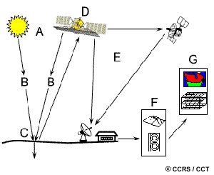
Stages in Remote Sensing
1. Energy Source or Illumination (A)
2. Radiation and the Atmosphere (B)
3. Interaction with the Target (C)
4. Recording of Energy by the Sensor (D)
5. Transmission, Reception, and Processing (E)
6. Interpretation and Analysis (F)
7. Application (G)

Slide 3
Physical basis of remote sensing
Understanding of electromagnetic energy and its properties is important in order to interpret remotely sensed data
Electromagnetic energy- energy propagated through space or through material media in the form of an interaction between electric and magnetic fields, moving with the velocity of light.
Forms of electromagnetic energy - visible light, radio waves, heat, ultraviolet rays and x-rays

Slide 4
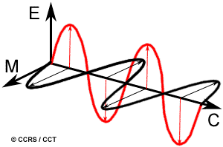
Electromagnetic radiation
consists of:
  An electrical field (E) which varies in magnitude in a direction perpendicular to the direction in which the radiation is traveling,
  A magnetic field (M) oriented at right angles to the electrical field. Both these fields travel at the speed of light (c).
All electromagnetic radiation has fundamental properties and behaves in predictable ways according to the basics of wave theory.

Slide 5
Wave theory
Electromagnetic wave is composed of quanta (photons) each with energy E = hf, where h is planck constant found 1900 to be about 6,63x10⁻³⁴ J. sec., and f is the frequency of the quanta given by f = c/I, where C is the velocity of light in vacuum, it is constant (3x10⁸ meter/sec. and I is the wave length of light wave.
EM are particularly important for understanding remote sensing. These are the wavelength and frequency
Wavelength and frequency are related by the following formula: C = f x I
Where I = wavelength (m), f = frequency (Hz), C = Speed of light
Notes:
J energy is measured in J (joule)

Slide 6
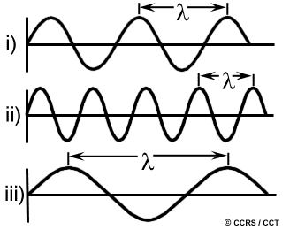
Wave theory
Two characteristics of electromagnetic radiation are particularly important for understanding remote sensing. These are the wavelength and frequency
In the example:
  ii) short wavelength and high frequency
  iii) long wavelength and low frequency
  C = speed of light is constant

Slide 7
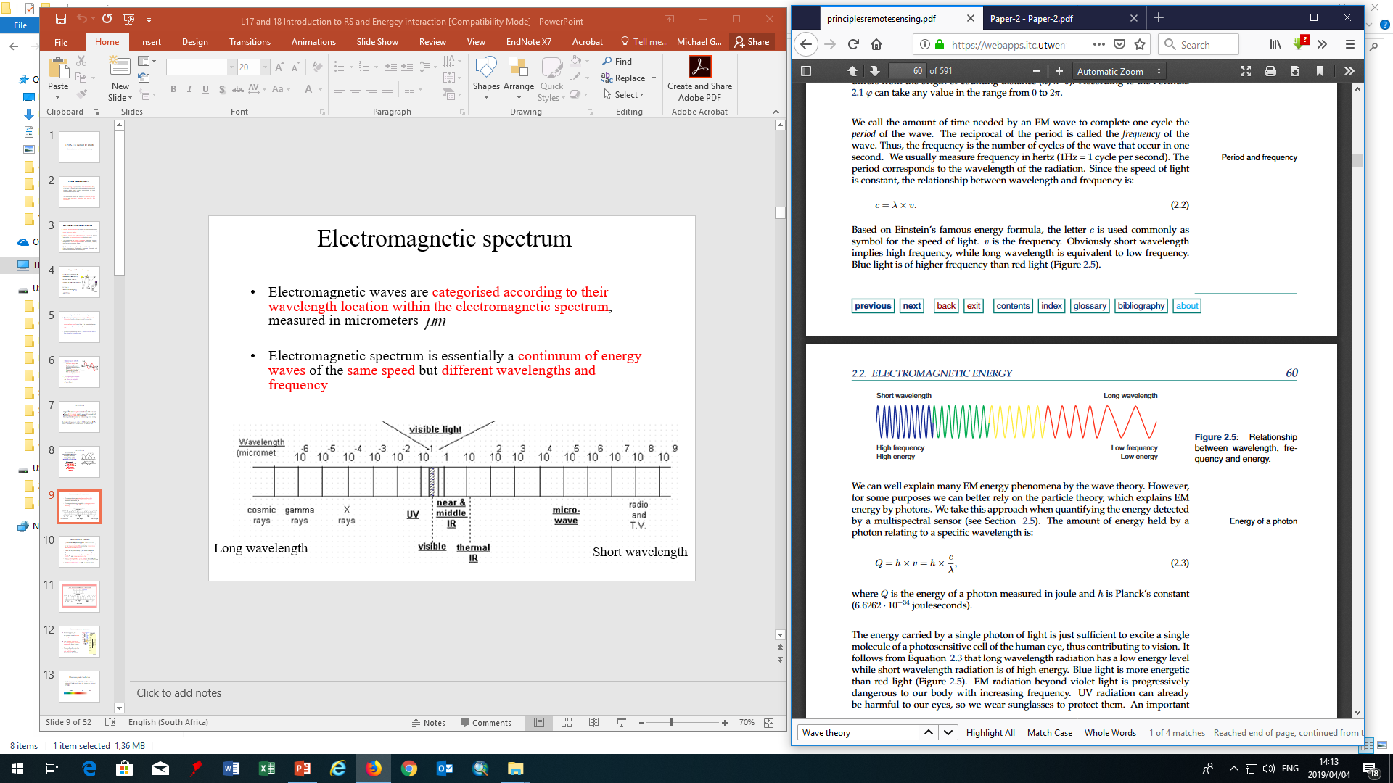
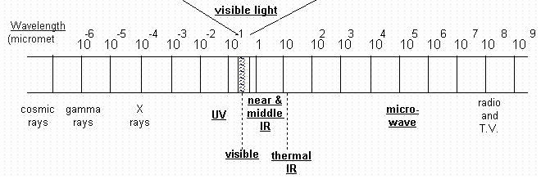
Electromagnetic spectrum
Electromagnetic waves are categorised according to their wavelength location within the electromagnetic spectrum, measured in micrometers
Electromagnetic spectrum is essentially a continuum of energy waves of the same speed but different wavelengths and frequency
short wavelength
high frequency
high energy
long wavelength
low frequency
low energy

Slide 8

Electromagnetic spectrum
The electromagnetic spectrum ranges from the shorter wavelengths (including gamma and x-rays) to the longer wavelengths (including microwaves and broadcast radio waves).
There are several regions of the electromagnetic spectrum which are useful for remote sensing.
The main regions used in RS are visible, infrared, 0.7-3 and microwave 1mm-1m
The visible light (blue, green, red) is defined by the sensitivity to the human eye stretching from 0.4-0.7
The thermal channel, 3-14 is being explored

Slide 9
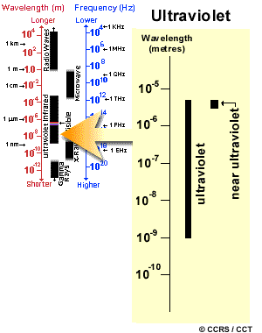
Electromagnetic spectrum
For most purposes, the ultraviolet or UV portion of the spectrum has the shortest wavelengths
This radiation is just beyond the violet portion of the visible wavelengths, hence its name
Some earth surface materials, primarily rocks and minerals, emit visible light when illuminated by UV radiation

Slide 10
Electromagnetic Radiation
Most sensors record within the visible and near infrared (VNIR) and within the shortwave infrared (SWIR).
VISIBLE
NIR
SWIR
400
500
600
700
800
900
1000
nm

Slide 11
Energy Transmission
EMR energy passes through a certain distance (path length) of the atmosphere
The atmosphere can have profound effects on the intensity and spectral composition of radiation available to any sensing system
Two main atmospheric effects are: scattering and absorption
The main atmospheric constituencies responsible for these processes are atmospheric gases (water vapour and ozone), aerosols and clouds

Slide 12
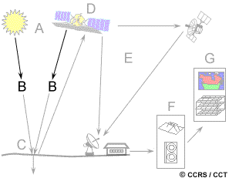
Interactions with the Atmosphere

Slide 13
Scattering
Occurs when particles or large gas molecules present in the atmosphere interact with and cause the EMR to be redirected from its original path.
Extent of scattering depends on several factors including
  wavelength of the radiation,
  the abundance of particles or gases,
  and the distance the radiation travels through the atmosphere.

Slide 14
Absorption
Is the other main mechanism at work when electromagnetic radiation interacts with the atmosphere.
In contrast to scattering, this phenomenon causes molecules in the atmosphere to absorb energy at various wavelengths.
Ozone, carbon dioxide, and water vapour are the three main atmospheric constituents which absorb radiation

Slide 15
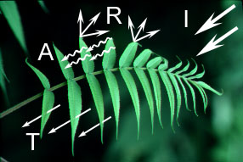
Radiation - Target Interactions
Radiation that is not absorbed or scattered in the atmosphere can reach and interact with the Earth's surface.
There are three (3) forms of interaction that can take place when energy strikes, or is incident (I) upon the surface. These are: absorption (A); transmission (T); and reflection (R).
The total incident energy will interact with the surface in one or more of these three ways.
The proportions of each will depend on the wavelength of the energy, the material and condition of the feature.

Slide 16
Absorption (A) occurs when radiation (energy) is absorbed into the target
Transmission (T) occurs when radiation passes through a target.
Reflection (R) occurs when radiation "bounces" off the target and is redirected.
In remote sensing, we are most interested in measuring the radiation reflected from targets.
We refer to two types of reflection, which represent the two extreme ends of the way in which energy is reflected from a target: specular reflection and diffuse reflection

Slide 17
Types of Reflection
When a surface is smooth we get specular or mirror-like reflection where all (or almost all) of the energy is directed away from the surface in a single direction.
Diffuse reflection occurs when the surface is rough and the energy is reflected almost uniformly in all directions.
Most earth surface features lie somewhere between perfectly specular or perfectly diffuse reflectors.
Whether a particular target reflects specularly or diffusely, or somewhere in between, depends on the surface roughness of the feature in comparison to the wavelength of the incoming radiation.
If the wavelengths are much smaller than the surface variations or the particle sizes that make up the surface, diffuse reflection will dominate.
e.g. fine-grained sand would appear fairly smooth to long wavelength microwaves but would appear quite rough to the visible wavelengths.

Slide 18
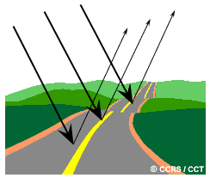
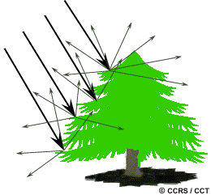
Specular reflection
Diffuse reflection

Slide 19
Spectral Reflectance Characteristics
Proportion of the reflected energy by a target depends on the wavelength of the incident radiation and the structure and composition of the target
for example
Structure
(e.g. broad vs. needle leaves; shallow vs. deep water body; fine vs. coarse grained soils)
or
Composition
(e.g. fresh vs. dry leaves; clear vs. murky water; humus vs. nutrient deficient soils )

Slide 20
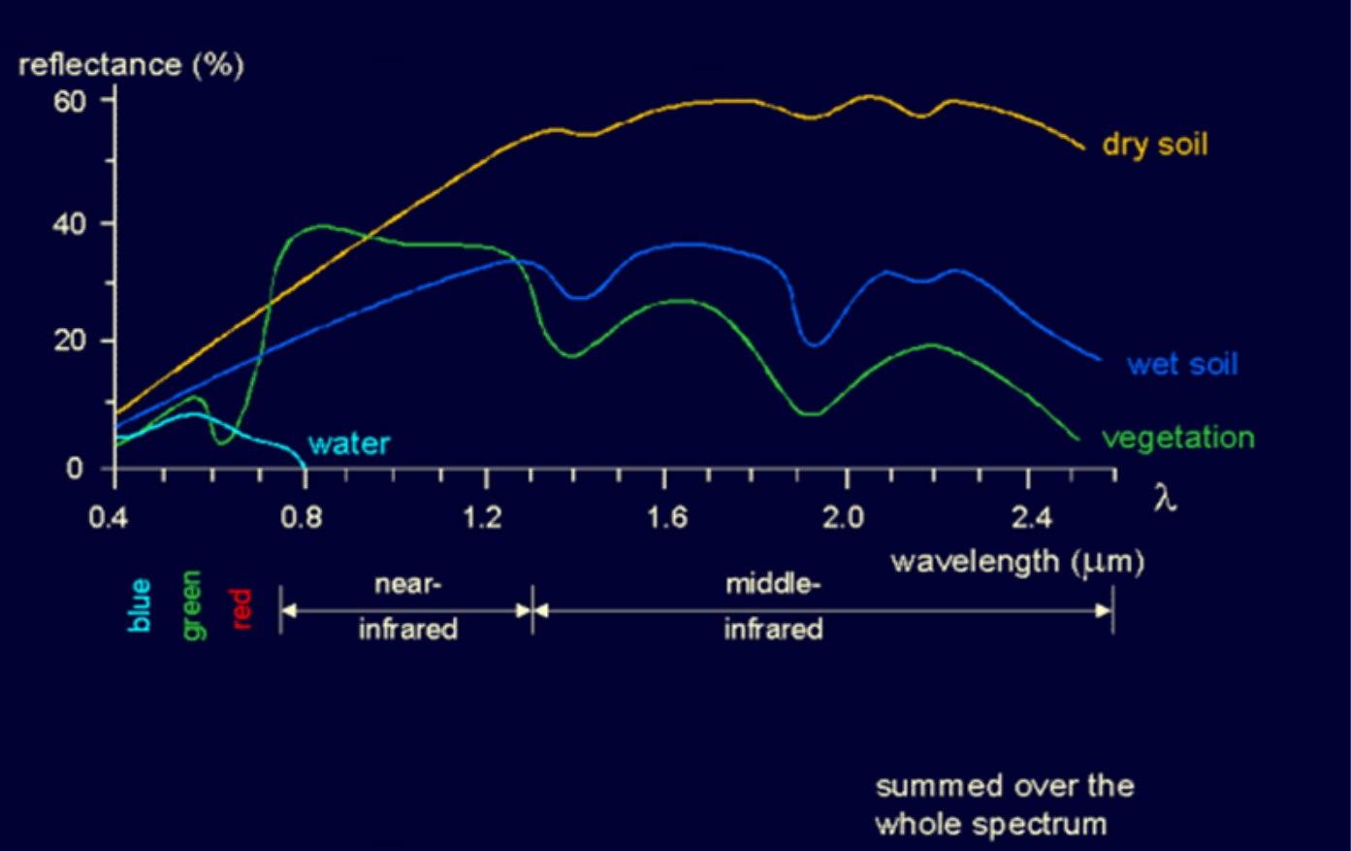
Measurement of Reflectance

Slide 21
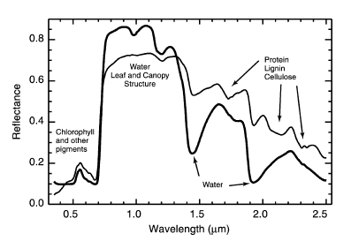
The General Vegetation Response
Reflectance depends on the properties of the leaves including biochemical content, orientation and the structure of the leaf canopy
Visible portion
      Absorption in the blue and red parts
      Reflection in the green part
    The main controlling factor is leaf pigments: chlorophyll & anthocyanin (water-soluble vacuolar pigments)
Notice

Slide 22
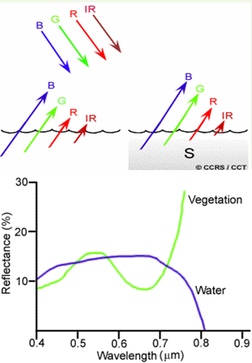
Reflectance characteristics of surface features : WATER
Suspended sediment (S) can be easily confused with shallow (but clear) water, since these two phenomena appear very similar.
Chlorophyll in algae absorbs more of the blue wavelengths and reflects the green, making the water appear more green in colour when algae is present.
The topography of the water surface (rough, smooth, floating materials, etc.) can also lead to complications for water-related interpretation due to potential problems of specular reflection and other influences on colour and brightness
H₂O with algae

Slide 23
Soil
Difficult to describe what a typical soil reflectance curve looks like, because Soil reflectance is a result of complex interactions in soil constituencies
  Moisture content
  Organic matter
  Texture
  Mineral content like iron oxide, lime
  Surface crusting

